Slide 1
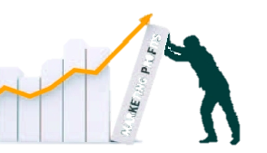
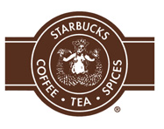
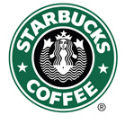
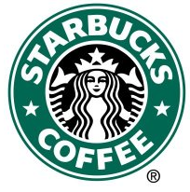

Product Positioning, Branding
and Product Line Strategies
MBM6
Chapter 7
1971
1987
Chapter 7 Objectives
Product Positioning & Positioning Strategies
Branding and Brand Management Strategies
Product Line Strategies
1992
2011
Why would Starbucks change it’s logo in 2011?
Copyright Roger J. Best, 2012

Slide 2
Product Positioning, Branding
and Product Line Strategies
MBM6
Chapter 7
Product Positioning & Positioning Strategies
In this section we will focus on different approaches to product positioning.
Copyright Roger J. Best, 2012

Slide 3
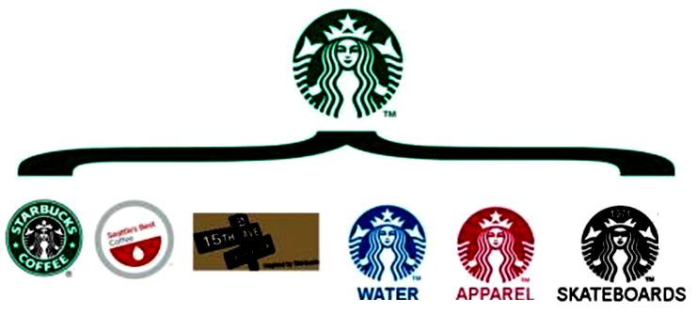
Starbucks Brand Strategy
MBM6
Chapter 7
Core Brand
Branded Product Lines
The new logo frees Starbucks from a pure coffee brand and allows for other products to evolve under the new brand logo.
Copyright Roger J. Best, 2012

Slide 4
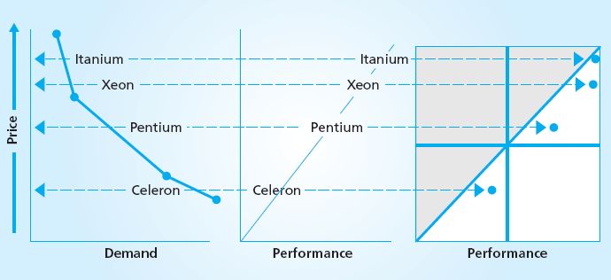
Intel Product Positioning Strategy
MBM6
Chapter 7
Year Introduced
Mid 2000’s
Late 1990’s
Early 1990’s
2000
What is the logic behind the Intel’s Product Positioning?
Why is Celeron a Fighter Brand?
Copyright Roger J. Best, 2012

Slide 5
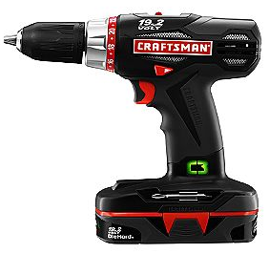
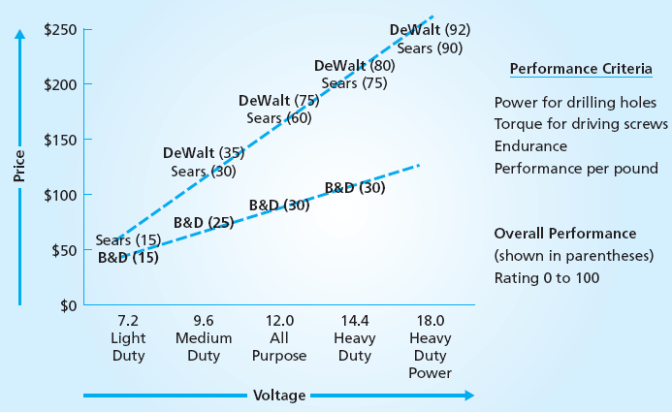
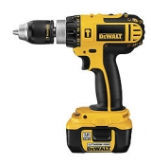
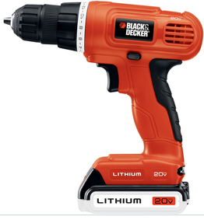
Black & Decker Positioning Strategy
MBM6
Chapter 7
Black & Decker (B&D) owns DeWalt.
Why don’t they use B&D with the DeWalt brand name?
Copyright Roger J. Best, 2012

Slide 6
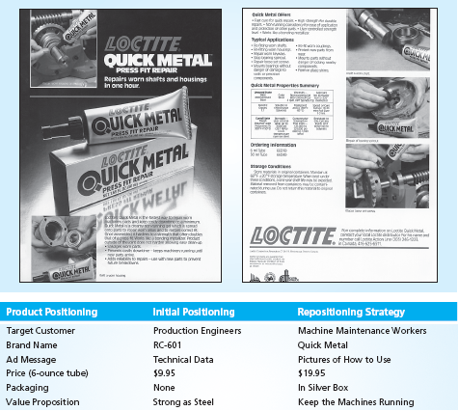
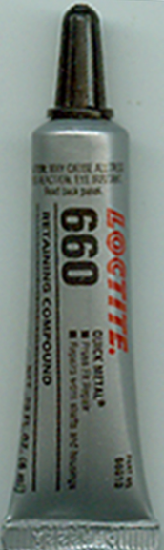
Repositioning Strategy
Marketing Performance Tool 7.1
Loctite Quick Metal
Copyright Roger J. Best, 2012

Slide 7
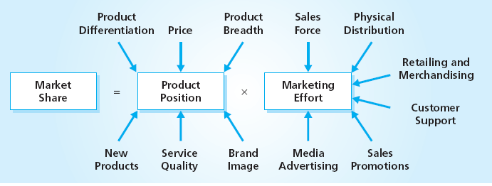
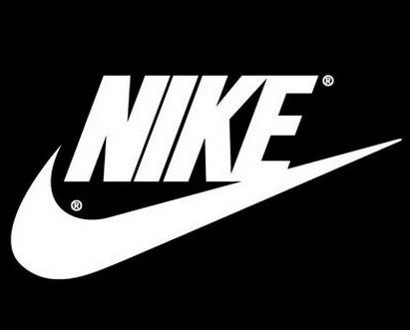
Nike Product Positioning
MBM6
Chapter 7
Product positioning has many elements. Explain how each play a role in Nike’s product position and market share.
Copyright Roger J. Best, 2012

Slide 8
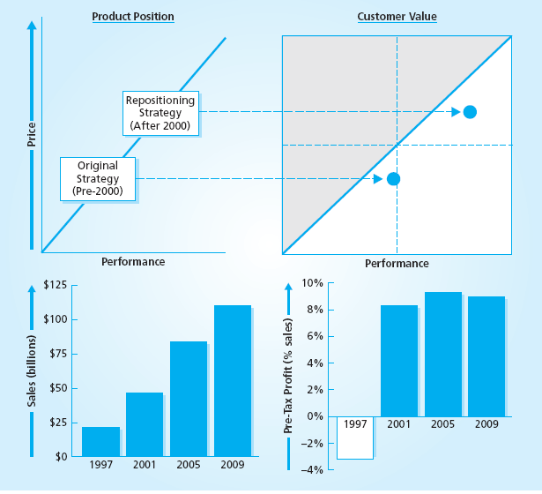

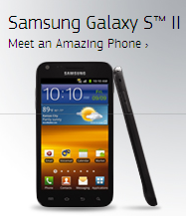
Samsung – Repositioning Strategy
MBM6
Chapter 7
Copyright Roger J. Best, 2012

Slide 9
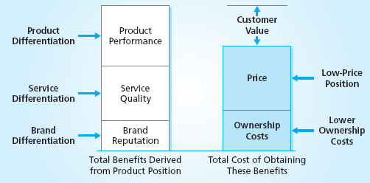
Positioning Strategies
MBM6
Chapter 7
Name a different company that has built it’s positioning strategy around one of the five area of positioning shown above.
Copyright Roger J. Best, 2012

Slide 10
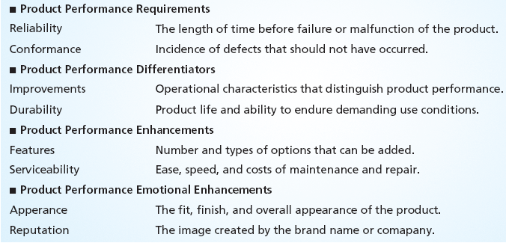
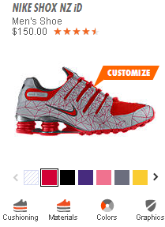
Nike Shoe Positioning
MBM6
Chapter 7
Which product features drive interest in this Nike shoe?
Copyright Roger J. Best, 2012

Slide 11
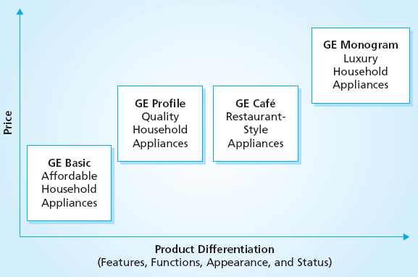
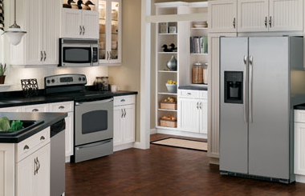
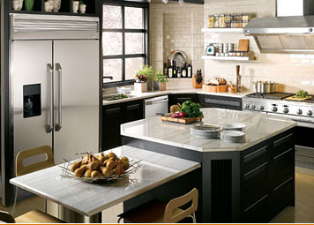
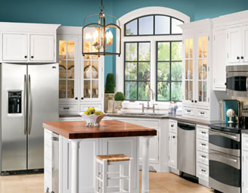
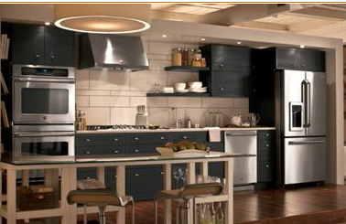
GE Appliance Product Line
Positioning Strategy
MBM6
Chapter 7
What is the logic behind GE’s Product Line Strategy?
Copyright Roger J. Best, 2012

Slide 12
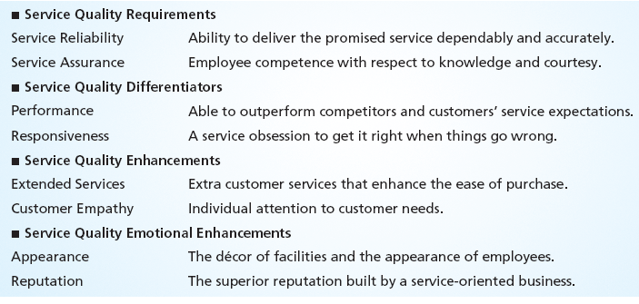
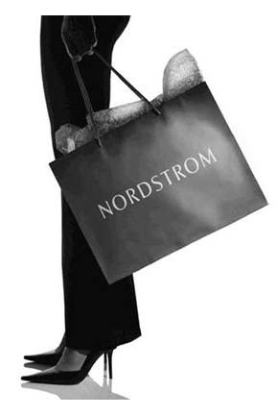
Nordstrom Service Quality
MBM6
Chapter 7
Customer service has become synonymous with Nordstrom
Every register at Nordstrom stores has pen and paper for customers to share their stories. Every morning before each store opens, Nordstrom employees gather in the main lobby for the store manager to share some of the best stories from the previous day and reward the employees in those stories.
Copyright Roger J. Best, 2012

Slide 13
Product Positioning, Branding
and Product Line Strategies
MBM6
Chapter 7
Branding & Brand
Management Strategies
In this section we will focus on different approaches to branding products and product lines.
Copyright Roger J. Best, 2012

Slide 14
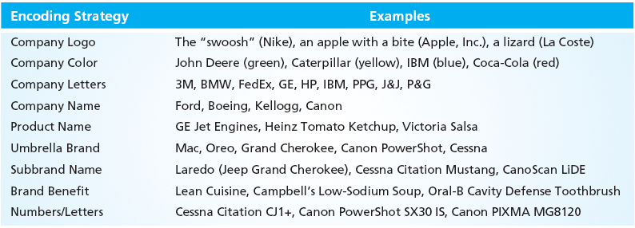
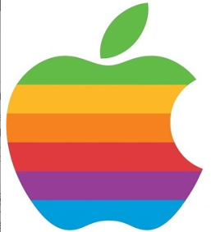
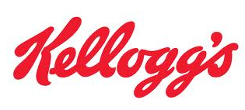
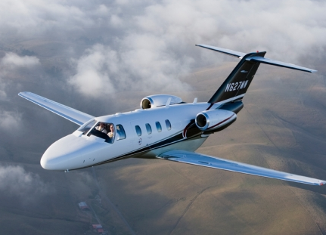


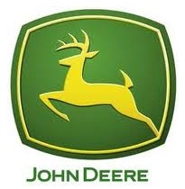
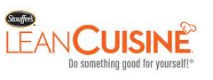
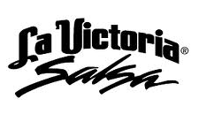

Branding Strategies
MBM6
Chapter 7
Cessna Citation CJ1+
Copyright Roger J. Best, 2012

Slide 15
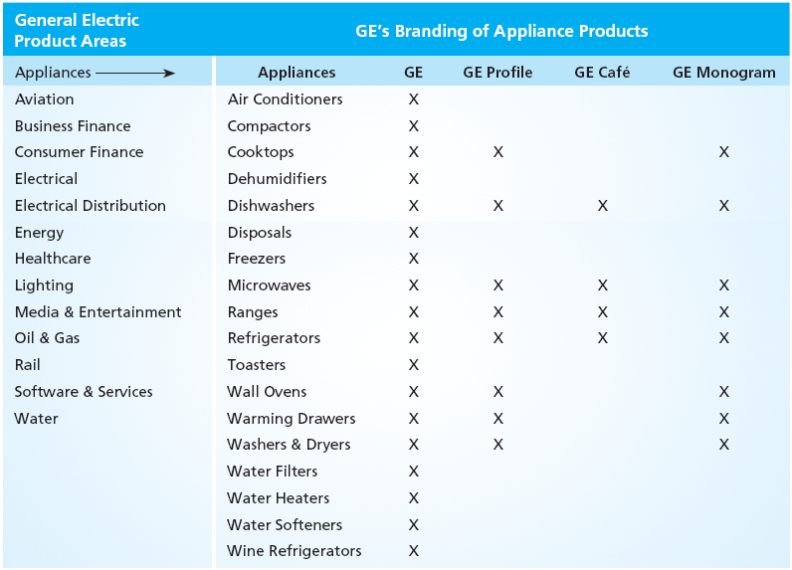
Company Name – Product Name
MBM6
Chapter 7
The new logo frees Starbucks from a pure coffee brand and allows for other products to evolve under the new brand logo.
Copyright Roger J. Best, 2012

Slide 16
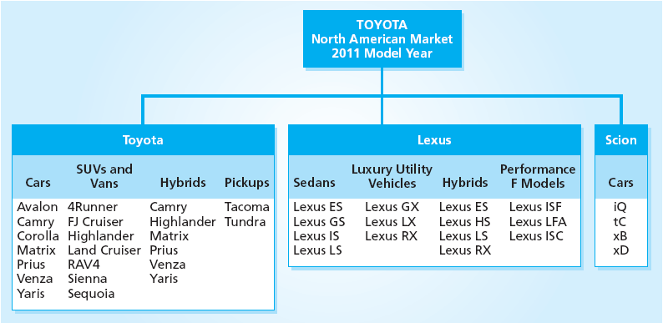
Toyota Brand Strategy
MBM6
Chapter 7
Why did Toyota introduce the Lexus brand?
Copyright Roger J. Best, 2012

Slide 17
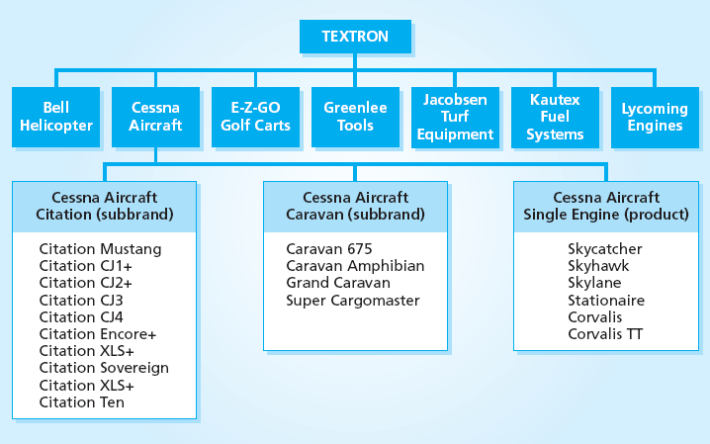
Textron’s Branding Strategy
MBM6
Chapter 7
What is Textron’s branding strategy?
Copyright Roger J. Best, 2012

Slide 18
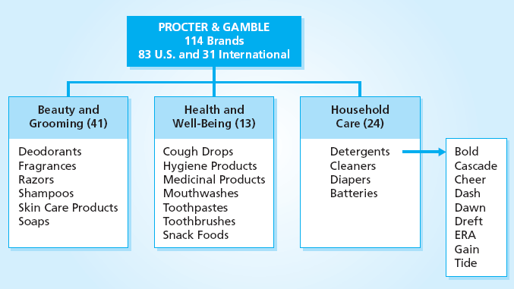
P & G’s Branding Strategy
MBM6
Chapter 7
What is P&G’s Detergent branding strategy?
Copyright Roger J. Best, 2012

Slide 19
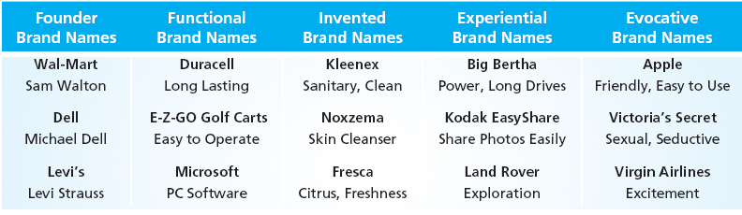
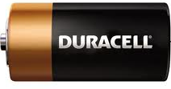
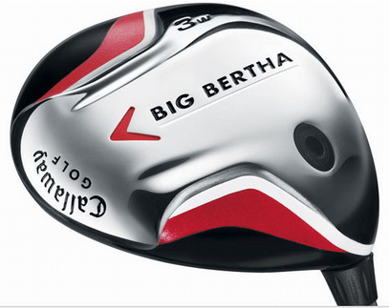


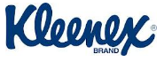
Brand Name Strategies
MBM6
Chapter 7
Copyright Roger J. Best, 2012

Slide 20
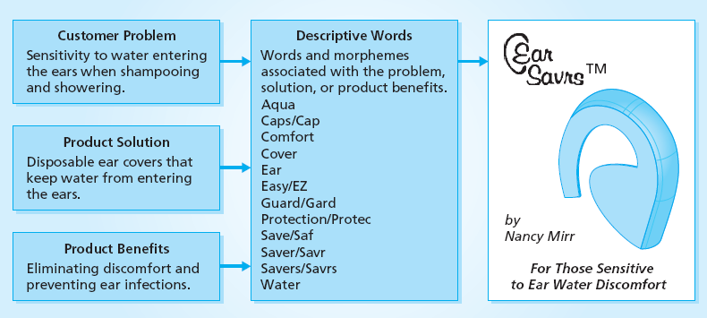
Developing a Brand Name
Marketing Performance Tool 7.2
Marketing Performance Tool 7.2 is designed to create a brand name such as the one above.
Copyright Roger J. Best, 2012

Slide 21
Product Positioning, Branding
and Product Line Strategies
MBM6
Chapter 7
Product Line Strategies
In this section we will look at different product line strategies.
Copyright Roger J. Best, 2012

Slide 22
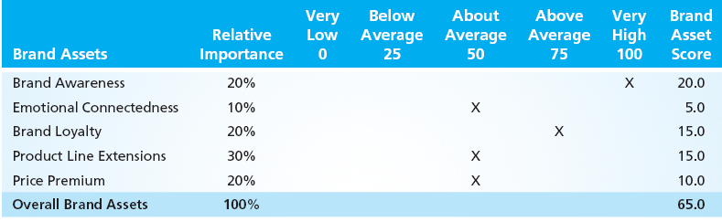
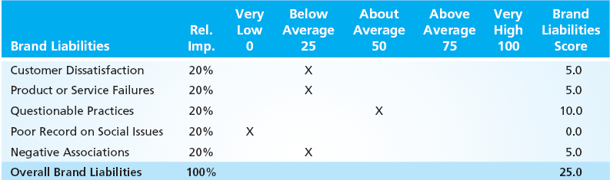
Brand Assets & Brand Liabilities
Marketing Performance Tool 7.3
Copyright Roger J. Best, 2012

Slide 23
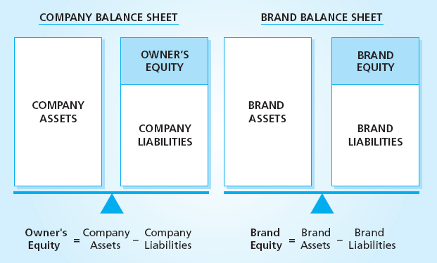
Measuring Brand Equity
MBM6
Chapter 7
How was Toyota’s brand equity effected by
Massive Toyota recalls in 2010 and 2011?
Copyright Roger J. Best, 2012

Slide 24
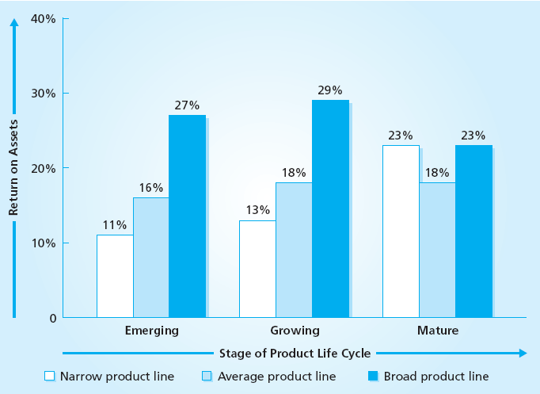
Product Line Breadth & Profitability
MBM6
Chapter 7
Why would companies with broader product lines be more profitable?
Copyright Roger J. Best, 2012

Slide 25
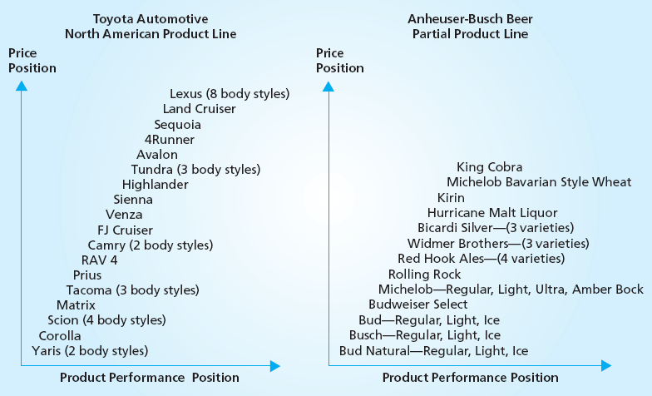
Product Line and Branding
MBM6
Chapter 7
Copyright Roger J. Best, 2012

Slide 26
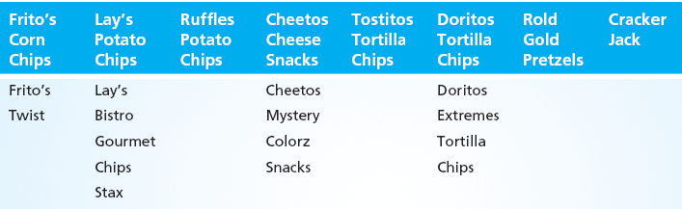
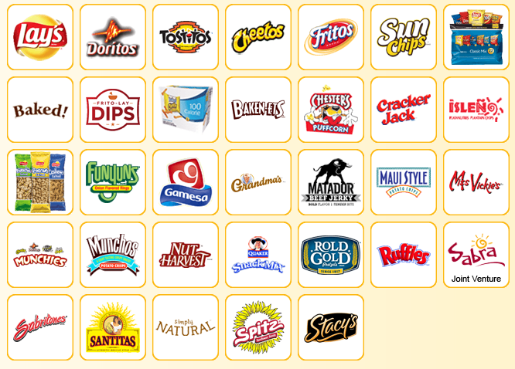
Frito-Lay Umbrella Brands
MBM6
Chapter 7
The Frito-Lay product line is differentiated by type of product and brand name.
Copyright Roger J. Best, 2012

Slide 27
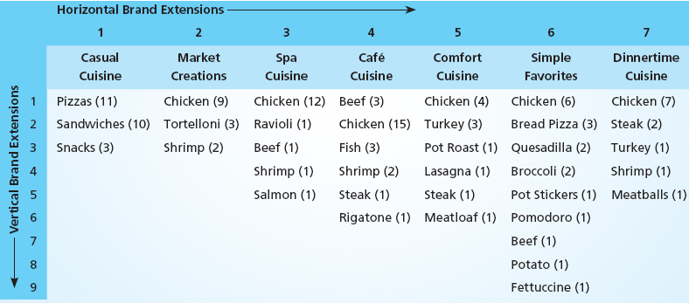

Lean Cuisine – Horizontal and
Vertical Product Line Strategy
MBM6
Chapter 7
How has this expanded product line lower the average cost of each product?
Copyright Roger J. Best, 2012

Slide 28


Honda Branding and
Product Line Strategy
MBM6
Chapter 7
How does the Honda name and image
help sell their extensive product line?
Copyright Roger J. Best, 2012

